Slide 1
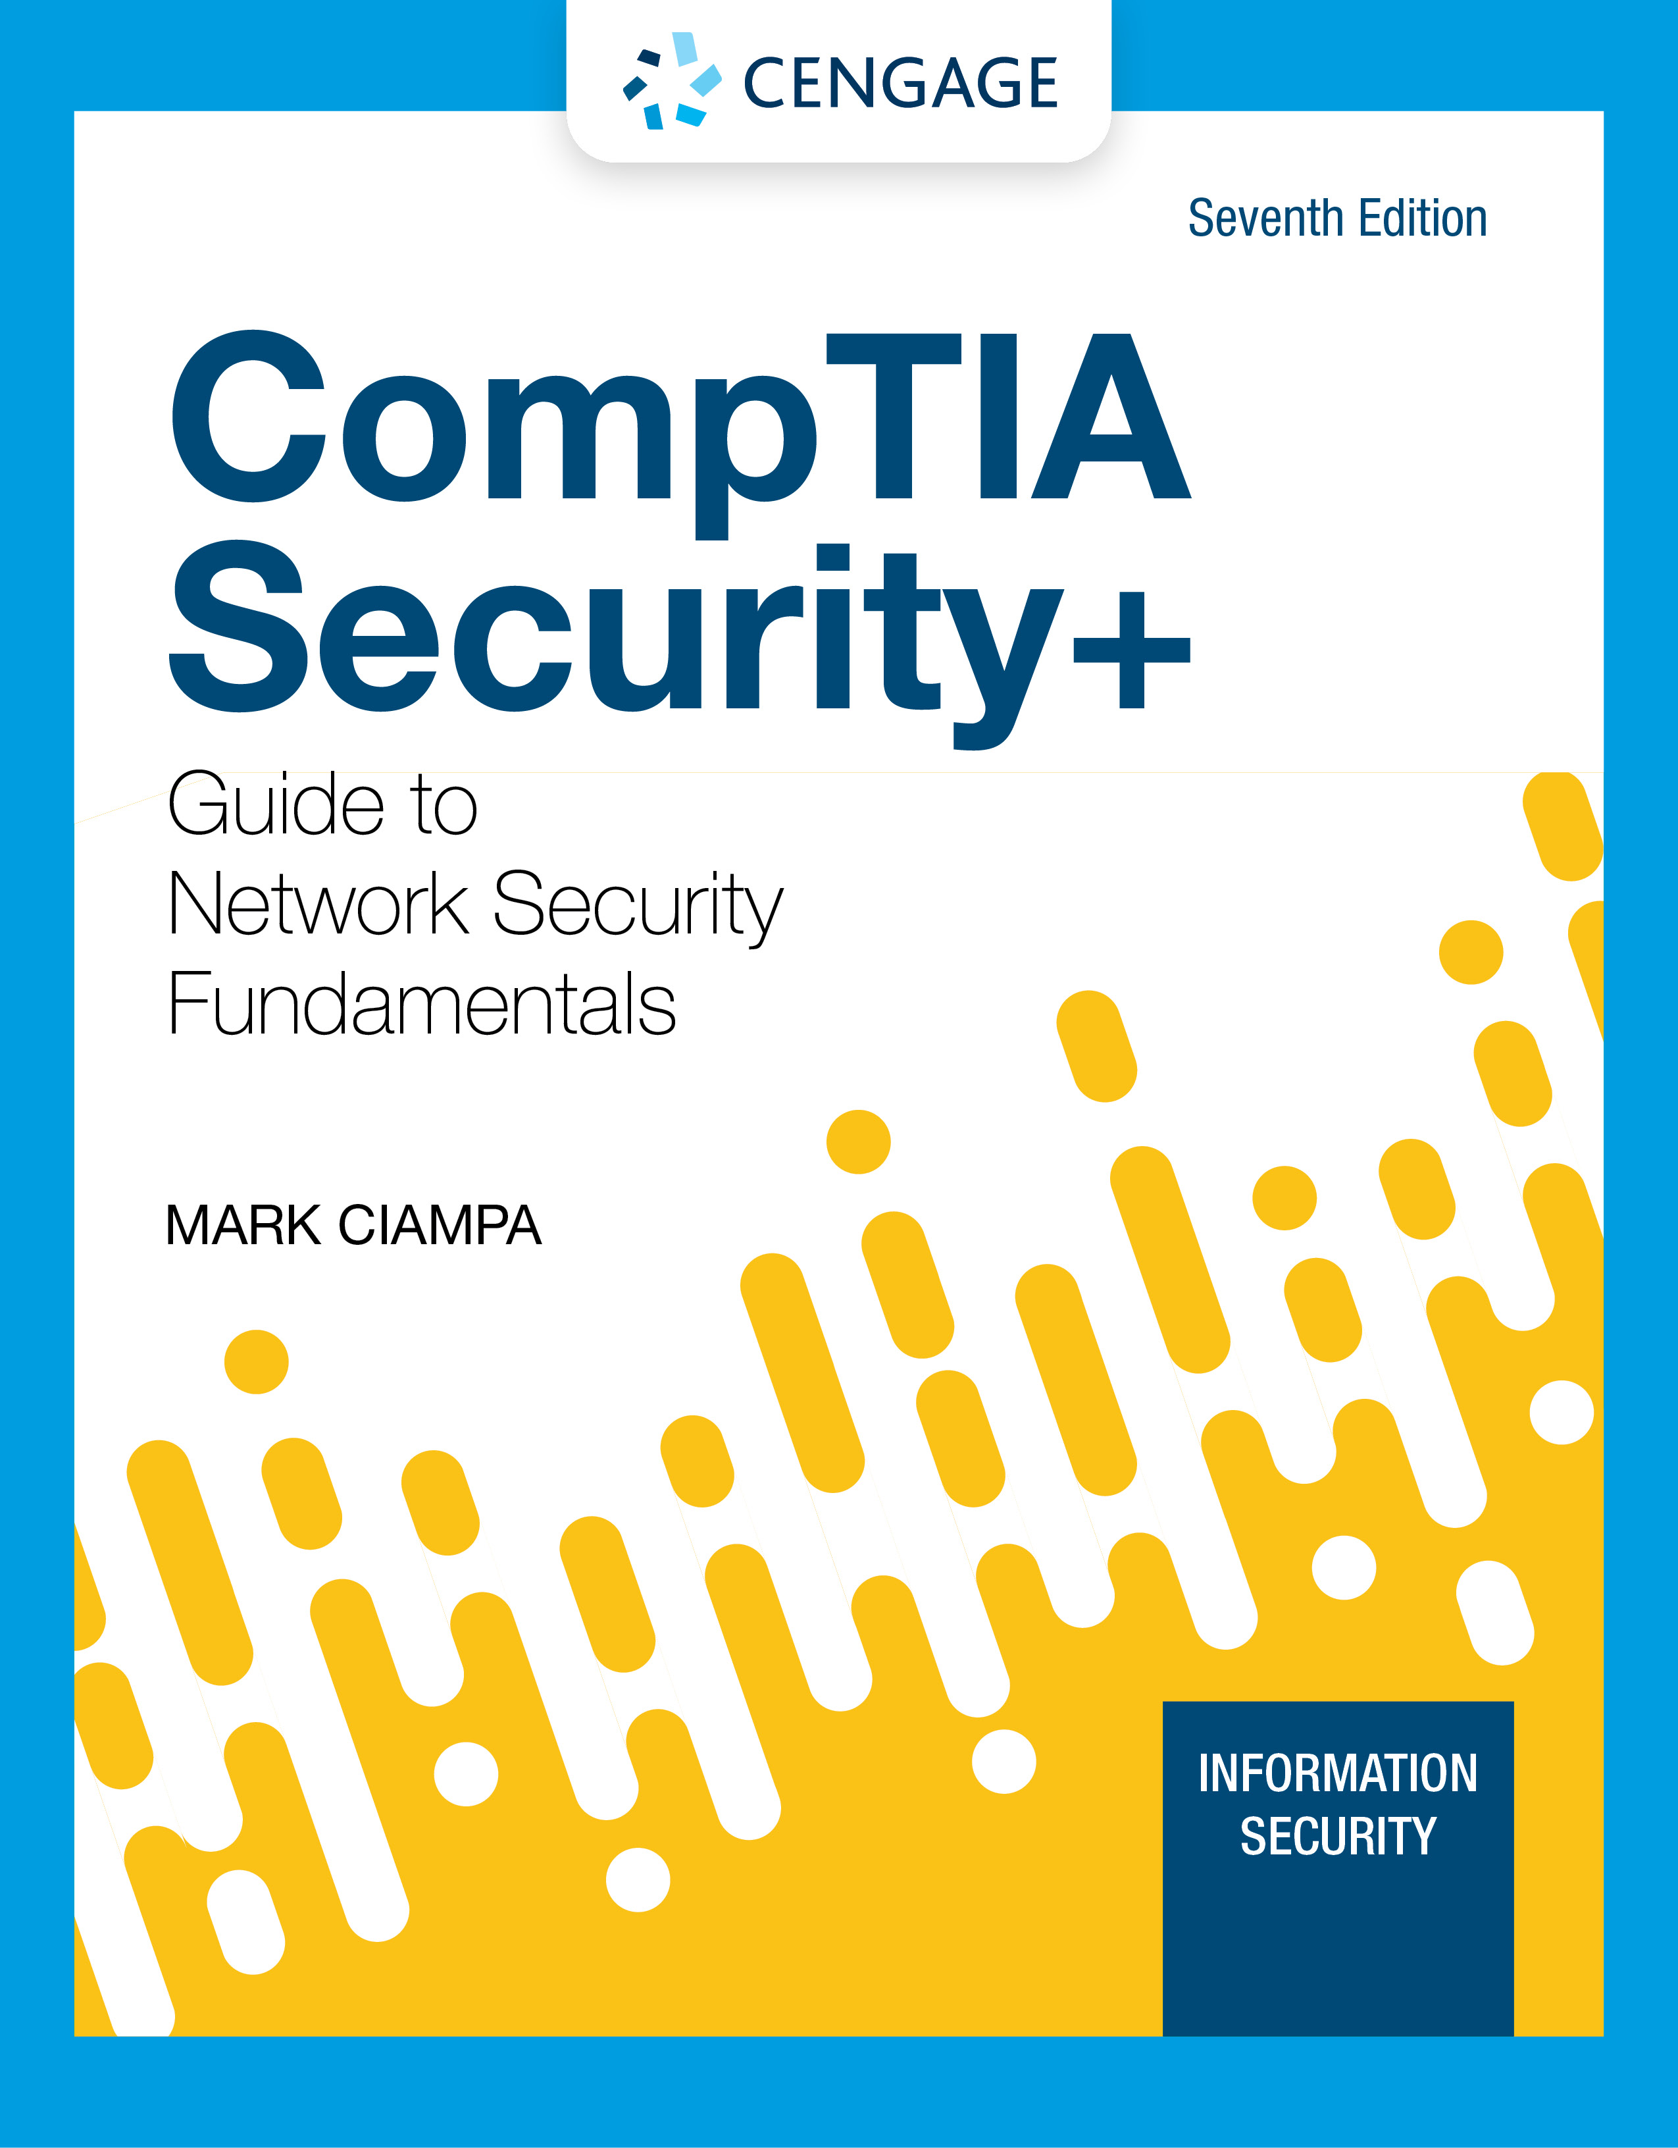
Module 1: Introduction to Security
CompTIA Security+ Guide
to Network Security Fundamentals, 7th Edition

Slide 2
Icebreaker: Class Introduction and Discussion
Question: Why is it important for all computer users, not just IT professionals, to understand the importance of network and computer security?
Each student should introduce themselves, explain why they are taking the class, and give their answer to the question.
If this is an online class, responses can be posted in the discussion board and each student should respond with a minimum of 100 words.
Notes:
Task: This is an introductory exercise for the beginning of a course.
Objectives: To provide an informal way for students to learn about each other and hear about why network and computer security is important to each of them. This exercise also gives students practice participating in a group setting and gives the instructor insight into who the students are and what is important to them.
Instructions: The instructor should pose the question in #1 to the class. Ask each student to introduce themselves, explain why they are taking the class, and then give their answer to the question.
Average Time In Class: 30 min
Note: to adapt this activity for an online learning environment, pose the discussion question in the discussion board in your LMS. Each student should respond with a minimum of 100 words.

Slide 3
Module Objectives
By the end of this module, you should be able to:
1. Define information security and explain why it is important
2. Identify threat actors and their attributes
3. Describe the different types of vulnerabilities and attacks
4. Explain the impact of attacks

Slide 4
What is Information Security?
The first step in understanding security is to define exactly what it is
Understanding Security
Security is:
To be free from danger, which is the goal of security
The process that achieves that freedom
As security is increased, convenience is often decreased
The more secure something is, the less convenient it may become to use

Slide 5
Defining Information Security (1 of 2)
Information security describes the tasks of securing digital information, whether it is:
Manipulated by a microprocessor
Preserved on a storage device
Transmitted over a network
There are three types of information protection (often called the CIA Triad) :
Confidentiality
Only approved individuals may access information
Integrity
Ensures information is correct and unaltered
Availability
Ensures information is accessible to authorized users

Slide 6
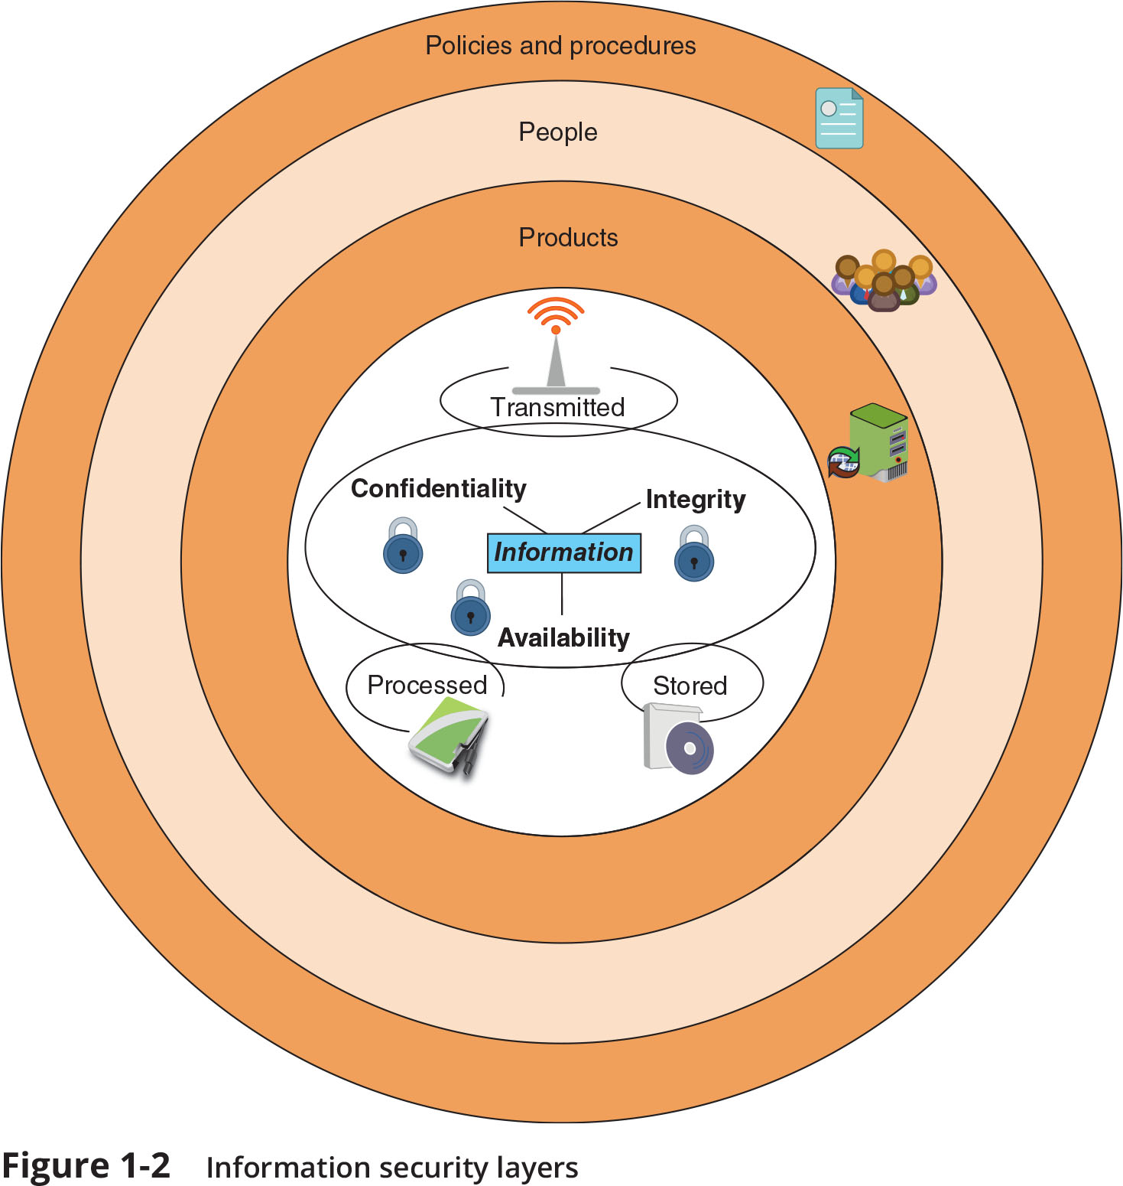
Defining Information Security (2 of 2)
Figure 1-2 Information security layers

Slide 7
Knowledge Check Activity 1
As security increases, the convenience of using a system is also increased.
a. True
b. False

Slide 8
Knowledge Check Activity 1: Answer
As security increases, the convenience of using a system is also increased.
Answer: b. False
As security increases, users of computer systems and software are usually required to perform additional tasks to abide by the security policies, making the use of they systems less convenient but more secure.

Slide 9
Who Are the Threat Actors?
A threat actor is an individual or entity responsible for cyber incidents against the technology equipment of enterprises and users
The generic term attacker is also commonly used
Financial crime is often divided into three categories based on targets:
Individual users
Enterprises
Governments
There are three types of hackers
Black hat hackers
White hat hackers
Gray hat hacker

Slide 10
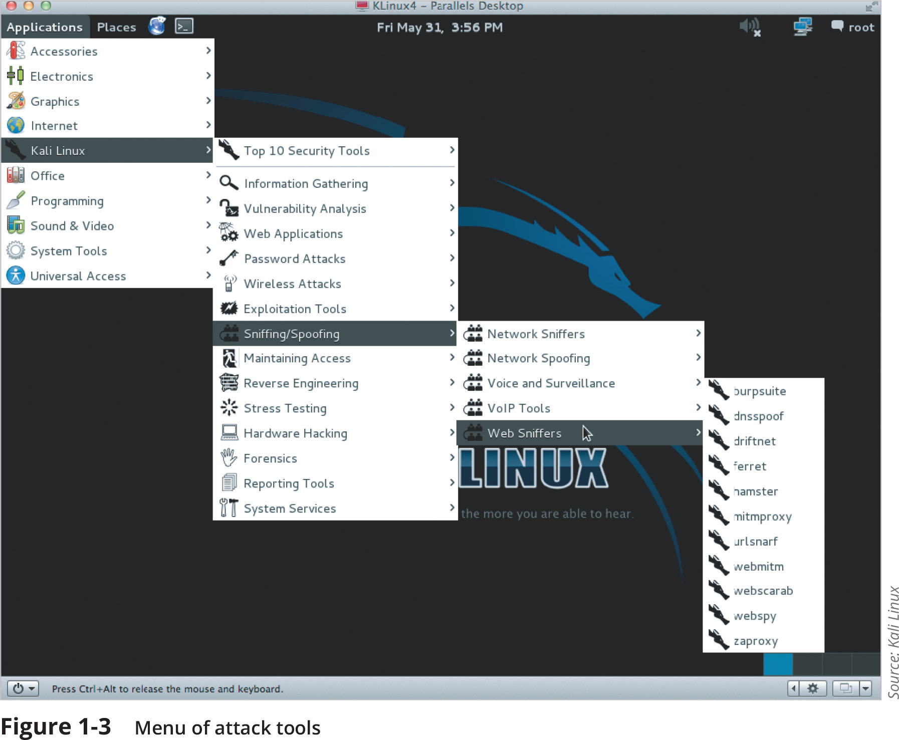
Script Kiddies
Script kiddies are individuals who want to perform attacks, yet lack technical knowledge to carry them out
They download freely available automated attack software and use it to attack

Slide 11
Hacktivists
Individuals that are strongly motivated by ideology (for the sake of their principles or beliefs) are hacktivists
The types of attacks by hacktivists often involved breaking into a website and changing its contents as a means of a political statement
Other attacks were retaliatory: hacktivists have disabled a bank’s website that didn’t allow online payments deposited into accounts belonging to groups supported by hacktivists

Slide 12
State Actors
Governments are increasingly employing their own state-sponsored attackers for launching cyberattacks against their foes
These attackers are known as state actors
Many security researchers believe that state actors might be the deadliest of any threat actors
State actors are often involved in multiyear intrusion campaigns targeting highly sensitive economic, proprietary, or national security information
A new class of attacks called advanced persistent threat (APT)
APTs are most commonly associated with state actors

Slide 13
Insiders
Employees, contractors, and business partners can pose an insider threat of manipulating data from the position of a trusted employee
These attacks are harder to recognize because they come from within the enterprise
Six out of 10 enterprises reported being a victim of at least one insider attack during 2019
The focus of the insiders was:
Intellectual property (IP) theft – 43%
Sabotage – 41%
Espionage – 32%

Slide 14
Other Threat Actors
Threat Actor | Description | Explanation
Competitors | Launch attacks against an opponent’s system to steal classified information. | May steal new product research or a list of current customers to gain a competitive advantage.
Criminal syndicates | Move from traditional criminal activities to more rewarding and less risky online attacks. | Usually run by a small number of experienced online criminal networks that do not commit crimes themselves but act as entrepreneurs.
Shadow IT | Employees become frustrated with the slow pace of acquiring technology, so they purchase and install their own equipment or resources in violation of company policies. | Installing personal equipment, unauthorized software, or using external cloud resources can create a weakness or expose sensitive corporate data.
Brokers | Sell their knowledge of a weakness to other attackers or governments. | Individuals who uncover weaknesses do not report it to the software vendor but instead sell them to the highest bidder who is willing to pay a high price for the unknown weakness.
Cyberterrorists | Attack a nation’s network and computer infrastructure to cause disruption and panic among citizens. | Targets may include a small group of computers or networks that can affect the largest number of users, such as the computers that control the electrical power grid of a state or region.

Slide 15
Knowledge Check Activity 2
Which type of threat actor is often involved in multiyear intrusion campaigns targeting highly sensitive economic, proprietary, or national security information?
a. Insider
b. State actor
c. Hacktivist
d. Script kiddie

Slide 16
Knowledge Check Activity 2: Answer
Which type of threat actor is often involved in multiyear intrusion campaigns targeting highly sensitive economic, proprietary, or national security information?
b. State actor
A state actor differs from other threat actors in that their attacks are sponsored by their government. The attacks are targeted at foreign governments and state infrastructures with the goal of gaining a competitive advantage on the world stage or in an actual warfare situation.

Slide 17
Vulnerabilities and Attacks
One of the most successful types of attack is social engineering
Social engineering does not even exploit technology vulnerabilities
Each successful attack has serious ramifications

Slide 18
Vulnerabilities (1 of 4)
A vulnerability is the state of being exposed to the possibility of being attacked or harmed
Cybersecurity vulnerabilities can be categorized into platforms, configurations, third parties, patches, and zero-day vulnerabilities
Platforms
A computer platform is a system that consists of the hardware device and an OS that runs software
All platforms have vulnerabilities to some degree, some platforms have serious vulnerabilities including:
Legacy platforms
On-premises platforms
Cloud platforms

Slide 19
Vulnerabilities (2 of 4)
Configuration settings are often not properly implemented
Results in weak configurations
See Table 1-3 for a list of several weak configurations that can result in vulnerabilities

Slide 20
Vulnerabilities (3 of 4)
Third Parties
Almost all businesses use external entities known as third parties
Examples of third parties include: outsourced code development, data storage facilities
Vendor management is the process organizations use to monitor and manage the interactions with all of their external third parties
Connectivity between the organization and the third party is known as system integration
One of the major risks of third-party system integration involves the principle of the weakest link

Slide 21
Vulnerabilities (4 of 4)
Patches
As important as patches are, they can create vulnerabilities:
Difficulty patching firmware
Few patches for application software
Delays in patching OSs
Zero Day
Vulnerabilities can be exploited by attackers before anyone else even knows it exists
This type of vulnerability is called a zero day because it provides zero days of warning
Zero-day vulnerabilities are considered extremely serious

Slide 22
Attack Vectors
An attack vector is a pathway or avenue used by a threat actor to penetrate a system
Attack vectors can be grouped into the following general categories:
Email
Wireless
Removable media
Direct access
Social media
Supply chain
Cloud

Slide 23
Social Engineering Attacks (1 of 8)
Social engineering is a means of eliciting information (gathering data) by relying on the weaknesses of individuals
It is also used as influence campaigns to sway attention and sympathy in a particular direction
These campaigns can be found exclusively on social media or may be combined with other sources
Psychological Principles
Attackers use a variety of techniques to gain trust:
Provide a reason
Project confidence
Use evasion and diversion
Make them laugh

Slide 24
Social Engineering Attacks (2 of 8)
Social engineering psychological approaches often involve:
Impersonation is masquerading as a real or fictitious character and then playing the role of that person with a victim
Phishing is sending an email message or displaying a web announcement that falsely claims to be from a legitimate enterprise in an attempt to trick the user into surrender private information or taking action
Variations on phishing attacks:
Spear phishing
Whaling
Vishing
Smishing

Slide 25
Social Engineering Attacks (3 of 8)
Social engineering psychological approaches often involve (continued):
Redirection is when an attacker directs a user to a fake lookalike site filled with ads for which the attacker receives money for traffic generated to the site
Attackers purchase fake sites because the domain names of sites are spelled similarly to actual sites (called typo squatting)
Another redirection technique is pharming where the attacker attempts to exploit how a URL is converted into its corresponding IP address
Spam is unsolicited email that is sent to a large number of recipients
Text-based spam messages can be filtered
Image spam cannot be filtered
Spim is spam delivered through instant messaging (IM) instead of email

Slide 26
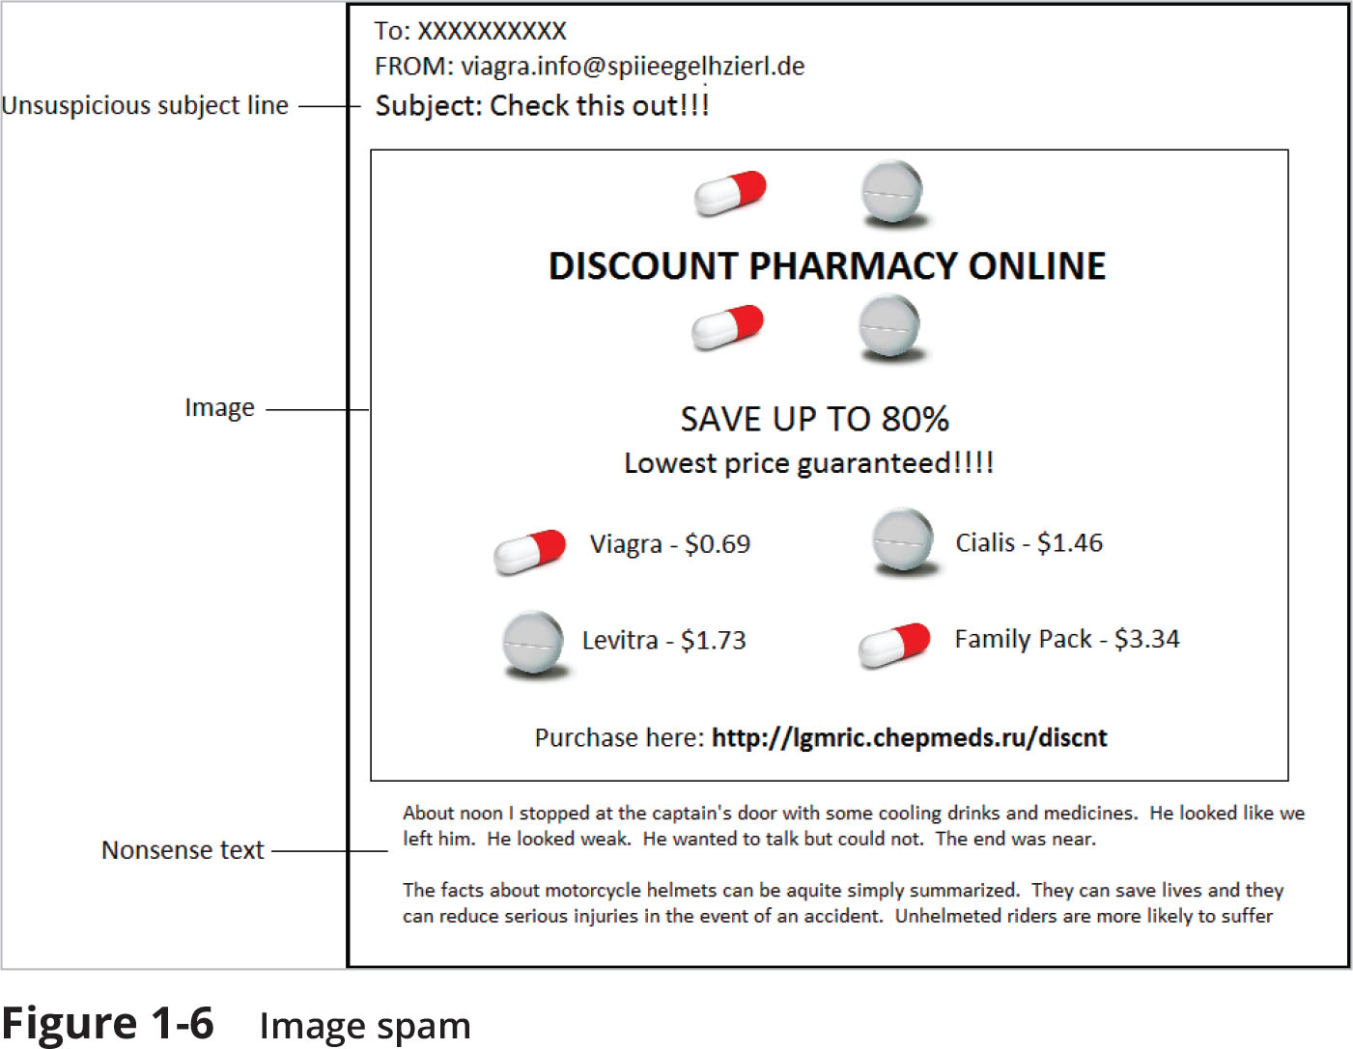
Social Engineering Attacks (4 of 8)
Figure 1-6 Image spam

Slide 27
Social Engineering Attacks (5 of 8)
Social engineering psychological approaches often involve (continued):
Hoaxes are false warnings, often contained in an email message claiming to come from the IT department
The hoax purports that there is a “deadly virus” circulating through the Internet and the recipient should erase specific files or change security configurations
A watering hole attack is directed toward a smaller group of specific individuals

Slide 28
Social Engineering Attacks (6 of 8)
Physical Procedures
Physical attacks take advantage of user actions that can result in compromised security
Three of the most common physical procedures are dumpster diving, tailgating, and shoulder surfing
Dumpster Diving involves digging through trash receptacles to find information that can be useful in an attack
An electronic variation of physical dumpster diving is to use the Google search engine to look for documents and data posted online that can be used in an attack (called Google dorking)

Slide 29
Social Engineering Attacks (7 of 8)
Item retrieved | Why useful
Calendars | A calendar can reveal which employees are out of town at a particular time.
Inexpensive computer hardware, such as USB flash drives or portal hard drives | These devices are often improperly disposed of and might contain valuable information.
Memos | Seemingly unimportant memos can often provide small bits of useful information for an attacker who is building an impersonation.
Organizational charts | These identify individuals within the organization who are in positions of authority.
Phone directories | A phone directory can provide the names and telephone numbers of individuals in the organization to target or impersonate.
Policy manuals | These may reveal the true level of security within the organization.
System manuals | A system manual can tell an attacker the type of computer system that is being used so that other research can be conducted to pinpoint vulnerabilities.

Slide 30
Social Engineering Attacks (8 of 8)
Physical Procedures (continued)
Tailgating occurs when an authorized person opens an entry door, one or more individuals can follow behind and also enter
Shoulder Surfing allows an attacker to casually observe someone entering secret information, such as the security codes on a door keypad

Slide 31
Knowledge Check Activity 3
Which type of attack is NOT a form of social engineering attack?
a. Watering hole
b. Hoax
c. Zero day
d. Tailgating

Slide 32
Knowledge Check Activity 3: Answer
Which type of attack is NOT a form of social engineering attack?
c. Zero day
Zero day attacks are attacks on vulnerabilities in software systems that are discovered by threat actors before the system developers can issue a patch to correct the vulnerability.

Slide 33
Impacts of Attacks (1 of 3)
A successful attack always results in several negative impacts
These impacts can be classified as:
Data impacts
Effects on the organization

Slide 34
Impacts of Attacks (2 of 3)
Impact | Description | Example
Data loss | Destroying data so that it cannot be recovered | Maliciously erasing patient data used for cancer research
Data exfiltration | Stealing data to distribute it to other parties | Taking a list of current customers and selling it to a competitor
Data breach | Stealing data to disclose it in an unauthorized fashion | Stealing credit card numbers to sell to other threat actors
Identity theft | Taking personally identifiable information to impersonate someone | Stealing a Social Security number to secure a bank loan in the victim’s name

Slide 35
Impacts of Attacks (3 of 3)
Effects on the Enterprise
The attack may make systems inaccessible (availability loss)
This results in lost productivity (financial loss)
Attacks may effect the public perception of the enterprise (reputation)

Slide 36
Knowledge Check Activity 4
Which type of data impact would result if an attacker stole a list of customers for the purpose of selling the list to a competitor?
a. Data loss
b. Data exfiltration
c. Data breach
d. Identity theft

Slide 37
Knowledge Check Activity 4: Answer
Which type of data impact would result if an attacker stole a list of customers for the purpose of selling the list to a competitor?
b. Data exfiltration
Data exfiltration is the stealing of data for the purpose of distributing it or selling it to other parties. Data exfiltration is a specific type of data breach but not all data breaches involve data exfiltration. For example, a data breach might change or corrupt data or deny access to the data by its owner.

Slide 38
Self-Assessment
Rate your competence of the following module objectives on a scale of 1 to 5 where 5 indicates you have full confidence in your competence of that objective and 1 indicates you have very little to no confidence in your competence of that objective. If you self-score less than 4 you should consider reviewing the module and related exercises:
1. Define information security and explain why it is important
2. Identify threat actors and their attributes
3. Describe the different types of vulnerabilities and attacks
4. Explain the impact of attacks

Slide 39
Summary (1 of 2)
Attacks against information security have grown astronomically in recent years
The information security workforce is usually divided into two broad categories: information security managerial personnel and information security technical personnel
Security can be defined as the necessary steps to protect from harm
The threat actors fall into several categories and exhibit different attributes
Script kiddies do their work by downloading automated attack software from websites and using it to break into computers
Cybersecurity vulnerabilities are often categorized into five broad categories: platforms, configurations, third parties, patches, and zero-day vulnerabilities
Modern hardware and software platforms provide a wide array of features and security settings

Slide 40
Summary (2 of 2)
An attack vector is a pathway or avenue used by a threat actor to penetrate a system
Social engineering is a means of eliciting information by relying on the weaknesses of individuals
A successful attack always results in several negative impacts: data loss, data exfiltration, data breach, and identity theft

